Slide 1
Segregated Testing
and
Continuous Quality
using
Maven and SonarQube
Matthew Copeland

Slide 2


































Titanium Sponsors
Platinum Sponsors
Gold Sponsors

Slide 3
What brought my interest in this topic?
Small Project (6.6k lines of code with comments removed.)
The tests took a couple of minutes to run each time.
All integration tests, and no unit tests.
Poor interface segregation and multiple responsibilities in each class.
Two files/classes contained 2.6k lines of code.
One of these classes had over 60 methods.
It made my brain hurt!

Slide 4
Segregated Testing
Separating out the slow tests from the fast tests for faster feedback.
Generally, the unit tests are fast via mocking, in-memory tricks, etc.
Generally, the integration tests take a bit longer.
A great debate rages on the Internet by people with a lot of time on there hands and strong opinions on what is The Right Way to do tests.
I'll show you what I found helpful and increased my productivity. Perhaps, it will be of use to you.

Slide 5
The Maven “Convention”
Unit tests and Integration Tests are separated by a file name convention.
Both sets of tests are intermingled in the same directory structure under src/test/java/.
Different tests are run in different maven phases. Pick the phase you want to eliminate some of them.

Slide 6
Maven - Unit Tests
Executed by the maven-surefire-plugin
Run during the test phase of maven
Runs all tests src/test/java/, which has the word Test at the end.
“mvn test” to run.

Slide 7
Maven – Integration Tests
Run by the maven-failsafe-plugin, which isn't contained in the default Maven parent pom.
Runs integration tests during the Maven integration-test phase.
Runs all tests src/test/java/, which have the characters IT at the end.
“mvn verify” will run all the steps through the post-integration phase. (It runs both unit and integration tests, since both phases are included in a verify.)

Slide 8
Maven – breaking the convention
Other options exist for ways of marking tests as either unit tests or integration tests.
  Junit Annotations
  Changing the filename pattern.
Beware: These may end up making your life more difficult, rather than less. Why am I not telling you just don't do it then?

Slide 9
The SonarQube Convention
SonarQube provides an alternative convention for separating tests under maven.
The SonarQube method is meant to provide simpler integration with SonarQube.
It makes use of maven multi-module projects.
Examples:
  https://github.com/SonarSource/sonar-examples/

Slide 10
SonarQube – Unit Tests
Unit tests are placed in the same place as for normal Maven Unit Tests described earlier.

Slide 11
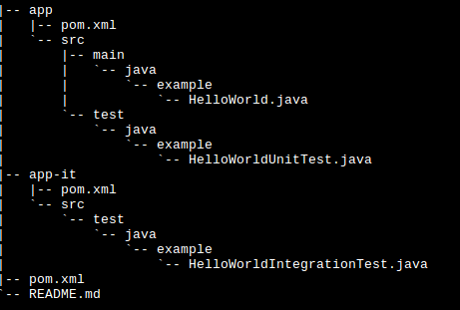
SonarQube – Integration Tests
Integration Tests are placed under a separate module.
Tests are run as unit tests in the other module, eliminating the need for the failsafe-plugin.

Slide 12
SonarQube – Breaking the Convention
If you want to break the convention to have unit and integration tests in the same project using the maven convention, expect to play around with the configuration a lot.
An example configuration can be found in my GitHub repos under segregated-testing-example.
Code Coverage and Test Success Rate will all show up under the Unit Tests section.
Requires running mvn -Dsonar.phase=verify sonar:sonar, rather than the normal mvn sonar:sonar to work.

Slide 13
Continuous Quality
A process to discover new ways of improving your projects by making measurements about your project characteristics and comparing against a desired base line.
Alternatively, a nice way of improving your own coding and design ability by having a tool to help point out where you may have screwed up, got lazy, or have a lack of knowledge.

Slide 14
It sounds painful. Why the heck would you want this?
It's less painful than the project I originally described for why I got into this.
It makes for more aware/better developers.
It's easier to improve things, if you can measure them in some way. Of course, some things can't be easily measured.

Slide 15
The Not So Integrated Approach
Find tools that scan your project as a part of the build.
If it finds a problem, break the build. (Fail Fast)
I started with this approach, but was forced to move it into a profile, since other developers on my team couldn't handle it as a part of the normal workflow.

Slide 16
Not So Integrated – Compiler Warnings
I recommend you do this whether you end up using SonarQube or not.
Have your compiler treat all warnings as errors. You will learn new things about your language of choice by doing this. This feature can save you from odd problems as you move between platforms and find bugs.
For Maven, use the maven-compiler-plugin to set the compiler to treat all warnings as errors.

Slide 17
No So Integrated – Build Breaker
For Java, FindBugs, PMD, and Check Style all have maven plugins, which you can have break your build if you violate a rule or copy-paste code.
If you do this, I suggest looking carefully at the CheckStyle rule set prior to implementation.
Alternatively, many IDEs have support for these tools, so that you can see them as your coding, rather than waiting until build time.
BEWARE: Including these maven-plugins will slow down your build and test feedback time.

Slide 18
SonarQube
SonarQube is an integrated Continuous Code Quality tool.
It provides a single place to go to get at your code quality metrics and has native integration with many Java code tools.
For the “I want the stats and tools, but I don't want to slow down my feedback.” crowd, leave off the extra plugins in maven, since SonarQube will run those for you.
SonarQube has support for many other tools and most major programming languages via plugins.
  Language List - http://www.sonarsource.com/products/plugins/languages/

Slide 19
What SonarQube isn't going to do for you.
Some things just can't be easily measured and analyzed by a program, in comparison to a person.
SonarQube is not an Automated Code Review tool. While it can assist you in doing code reviews, it will sometimes gloss over things you or I would look at and say isn't correct.
You still have to review one another's code, if you want good design and to do appropriate knowledge transfer.
It's not going to be able to tell you if you have a poor overall architectural design.

Slide 20
What can SonarQube do for you?
Help you determine the following about your code:
  Test Code Success Rate and Code Coverage
  Coding Practices and Bugs Issues via Static Analysis
  Code Design Issues
  Rate of improvement in covering issues
  Cross Project dependency usage

Slide 21
How's my Testing?
Let's look at two scenarios:
  I've had several conversations with developers attempting to figure out at what point have they done “enough testing”.
  You have a QA department, who handles manual testing, but they are understaffed, and are trying to figure out which parts of the program should they focus on testing.

Slide 22
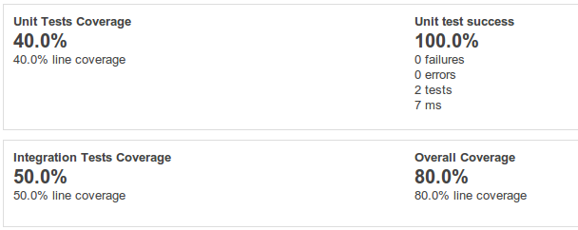
SonarQube – Code Coverage
SonarQube can provide you views into the coverage of your tests against your code. Notice how it provides overall coverage and broken out coverage.

Slide 23
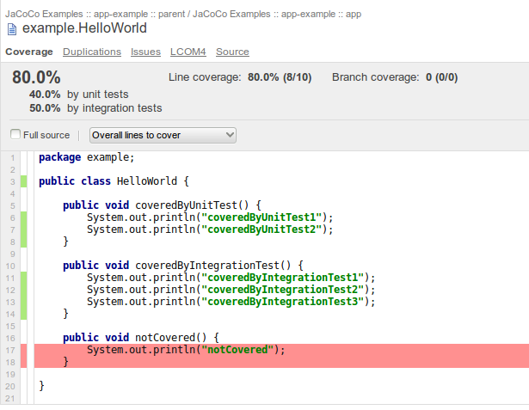
The Unit Test Success covers the success of both your unit and integration tests. If it's not a 100%, you know you have a problem.
The percentages are clickable, taking you to places, where you can see more information about which lines aren't covered.

Slide 24
If you are the person sitting in QA, then being able to look at this kind of information is very useful to know exactly what doesn't have coverage and should have some extra time manually testing.
If your code coverage is low enough for a class, SonarQube will raise it as an issue in it's Issues section.

Slide 25
What issues exist with my coding practices?
A lot of bugs and security issues in code aren't design related, but are simple coding practice errors. Many of these can be detected via Static Analysis.
Sometimes we do things because we are in a hurry and attempting to meet a deadline. SonarQube can help point some of these out for clean-up.
  Lack of Code comments on APIs
  Useless Code that will never be executed
  A little to much of the Copy / Paste, rather than factoring out common code.

Slide 26
SonarQube – Static Analysis
“It is impossible to do a true control test in software development, but I feel the success that we have had with code analysis has been clear enough that I will say plainly it is irresponsible to not use it” -- John Carmack (www.altdevblogaday.com/2011/12/24/static-code-analysis)
If static analysis/lint tools exist for your language and you aren't using them, you are missing out on free bug detection.
SonarQube comes with FindBugs, an open source static analysis tool. It has plugins for integrating with Fortify Static Code Analyzer and Coverity, which are two other common Commercial Static Analysis tools. These tools can detect both security and non-security related bugs in your code and put them into a issue list.

Slide 27
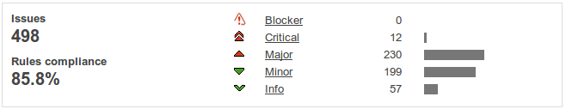
SonarQube – the Issues List
When one of the code analyzers detects an issue, it will be recorded in the clickable Issues dashboard in SonarQube.

Slide 28
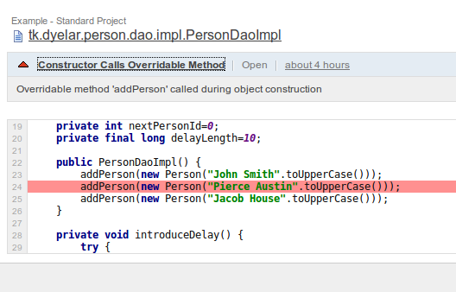
By drilling down, you can see exactly where the issue is located, and if you click on the title, you can get an explanation of the issue and sometimes how to resolve it.

Slide 29
Useless code, code which will never be reached, also will show up among the issues.
Using the right sonar plugins, Security Violations will show up in there own dashboard.
By enabling the right plugins, you can also feed sonar issues back into an issue system and even assign them to the responsible programmer.

Slide 30
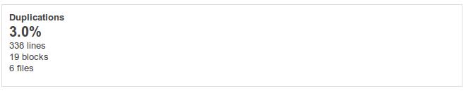
SonarQube – Code Duplication
Are some of your developers not practicing the DRY principle? SonarQube can help find these instances, especially across projects.
Enable cross project scanning in the settings and look at the Duplications Dashboard.

Slide 31
The dashboard is clickable and can take you right to where people have been using a little to much copy / paste.
Lest you think I'm making something out of nothing, I've seen a project where 25% of the code had been copy / pasted from another internal project, rather than factoring it out.
Several bugs didn't get fixed across projects properly due to this.

Slide 32
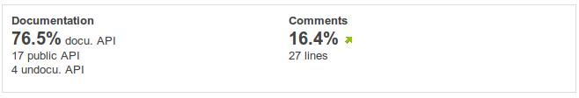
SonarQube – Code Docs
How well are your public APIs documented?
Are your developers commenting to little or to much?
SonarQube will provide a nice view into how well things are being documented and what improvements are being made over time.

Slide 33
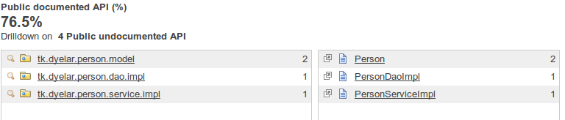
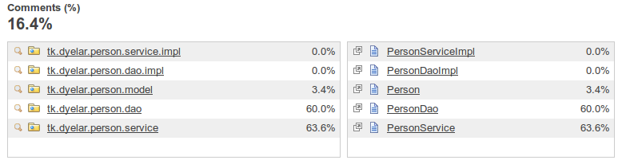
By drilling into the numbers, you can see specific hot spots.

Slide 34
What issues exist with my code design?
Do you have sections of code where A depends on B, but B also depends on A?
Do you have methods or classes which are overly complex?
Do your objects follow the Single Responsibility Principle?
Are you practicing good Interface Segregation?
Are you depending upon Abstractions, rather than Concrete Implementations? (Dependency Inversion Principle)

Slide 35
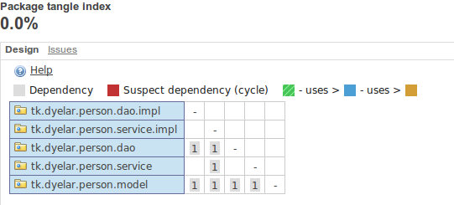
Finding dependency problems in code
SonarQube has a Package Tangle Index, which can be used to detect dependency issues. Notice in the graph below how nothing depends on the concrete implementations.

Slide 36
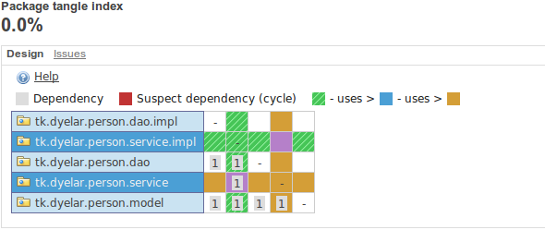
By clicking on different squares in the graph, you can get utilization across packages, and if you drill down into a package, between components.

Slide 37
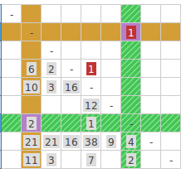
If you see red in the graph, you should be looking for cycles.

Slide 38
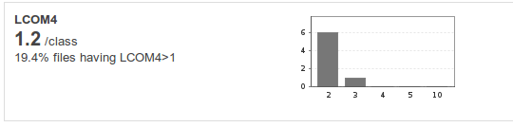
SonarQube – LCOM4
SonarQube has facilities to help you figure out if your objects are doing to much.
If you have an LCOM4 score for a class above 1, then you probably have two responsibilities in the same class. By drilling down, you can see the offending classes.

Slide 39
Be aware, if you aren't practicing good interface segregation and start passing around God objects of state, this isn't going to necessarily pick up that you've messed up.
Remember, it's not a replacement for code review. Don't let other developers point to things and say “See! The LCOM4 score is fine. My code is good”, if it really isn't. You'll be the one to deal with it later, when they leave.

Slide 40
SonarQube – RFC
Response for Class (RFC) is an indicator of the number of “friends” a class has.
It's determined by looking at the number of methods and constructors a class calls, including it's own.
A high RFC means a class is going to be harder to understand. You will have to spend more time looking at it to make sure any changes you make are the correct ones.

Slide 41
SonarQube - Coupling
SonarQube provides views into Efferent and Afferent Coupling at the File level. These values are only available, when you drill all the way down to the file level.
Be aware, the SonarQube product keeps moving these values around within the software.

Slide 42
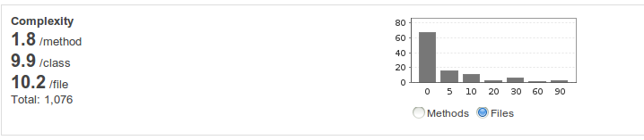
SonarQube – Cyclomatic Complexity
Also known as the “You packed how many try-catch and if statements into that one method” metric.
I've seen the validation method with 50 nested if statements. It was incomprehensible.
SonarQube can help you find those areas with the Complexity Dashboard.

Slide 43
By drilling down, you can find the classes with high numbers and start the work of untangling the mess.

Slide 44
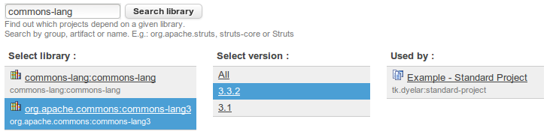
My manager wants to know...
Let's say you have all your projects in SonarQube now and a security vulnerability comes out with the Apache Commons-Lang3 dependency, if you are using version 3.3.2.
SonarQube can help. It has tools for searching across your maven dependencies in projects, so that you know what needs to be fixed.

Slide 45
Management - Are we Improving?
Developers and Managers often want to know whether they are improving in common coding practices. SonarQube provides help with this also.
SonarQube will provide arrows within the dashboards to tell you if the value is going up or down and by selecting the “Time changes...” drop down on the project page, you can change the time period that it is using for these indicators.

Slide 46
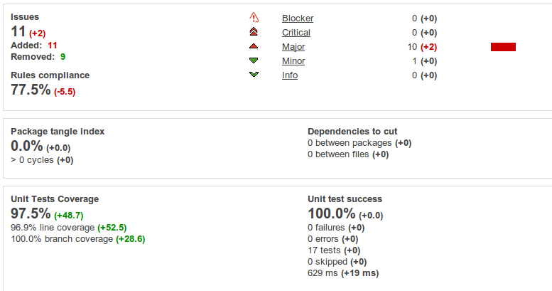
The following is the delta over the last 30 days for the example project I was working on for this presentation for a small set of the dashboards:

Slide 47
Make it a habit
By using SonarQube as you do your development, you can start to see where you as a developer or your project might be heading off track. It's much easier to do as you go along, versus waiting until the end to try and fix it all at once.
It can integrate with Continuous Integration (Jenkins/Hudson) and trackers, like Jira or RedMine.

Slide 48
Final Thoughts...
If you are interested in learning more, I highly recommend SonarQube in Action by G. Ann Campbell and Patroklos P. Papapetrou, published by Manning Publications.
SonarQube isn't quite ready for Java 8 from the static analysis tools perspective, if you've already upgraded. The tool is going through a lot of development to support the new features, and is supposed to be ready “some time soon.”
Some great community plug-ins also exist for SonarQube.

Slide 49
Questions?
Matthew Copeland
Email: dyelar@gmail.com
Twitter: @dyelar
GitHub: https://github.com/dyelar/
Example code for breaking conventions and these slides can be found in my GitHub Repo under segregated-testing-and-continuous-quality.
Feel free to contact me with questions.

